Slide 1

Deep Learning

Slide 2
What is Machine Learning?

Slide 3

Common ML Algorithms
Linear Regression
Logistic Regression
Support Vector Machine
Decision Tree
K-Nearest Neighbor
Recurrent Neural Network
Convolutional Neural Network
=

Slide 4
Common ML Algorithms
Linear Regression
Logistic Regression
Support Vector Machine
Decision Tree
K-Nearest Neighbor
Recurrent Neural Network
Convolutional Neural Network
=

Slide 5


DATA
ALGORITHM
MODEL

Slide 6

DATA
ALGORITHM
MODEL
NEW DATA
MODEL
PREDICTIONS

Slide 7

Music
Song | Artist | Genre | Liked
Breathing Light | Frameworks | Alternative Rock | Yes
Superior | Silver Maple | Pop | No
Icicle | AK | Pop | No
Jazzin | Flap Jack | R&B | Yes
The Way You Do | Schlomo | R&B | Yes
Mirror Maru | Cashmere | Rock | Yes
Never Too Far | Sorrow | Pop | No

Slide 8
Music
Features
(X)
Song | Artist | Genre | Liked
Breathing Light | Frameworks | Alternative Rock | Yes
Superior | Silver Maple | Pop | No
Icicle | AK | Pop | No
Jazzin | Flap Jack | R&B | Yes
The Way You Do | Schlomo | R&B | Yes
Mirror Maru | Cashmere | Rock | Yes
Never Too Far | Sorrow | Pop | No

Slide 9
Music
Song | Artist | Genre | Liked
Breathing Light | Frameworks | Alternative Rock | Yes
Superior | Silver Maple | Pop | No
Icicle | AK | Pop | No
Jazzin | Flap Jack | R&B | Yes
The Way You Do | Schlomo | R&B | Yes
Mirror Maru | Cashmere | Rock | Yes
Never Too Far | Sorrow | Pop | No
Target
(y)

Slide 10
Music
Song | Artist | Genre | Liked
Breathing Light | Frameworks | Alternative Rock | Yes
Superior | Silver Maple | Pop | No
Icicle | AK | Pop | No
Jazzin | Flap Jack | R&B | Yes
The Way You Do | Schlomo | R&B | Yes
Mirror Maru | Cashmere | Rock | Yes
Never Too Far | Sorrow | Pop | No
Labels

Slide 11
Model Training

Slide 12
Model Training
DATA
MODEL

Slide 13
Model Training
Prediction
0
1
0
0
1
0
DATA
MODEL

Slide 14
Model Training
Prediction | Label
0 | 1
1 | 1
0 | 0
0 | 1
1 | 0
0 | 0
DATA
MODEL

Slide 15
Model Training
Prediction | Label
0 | 1
1 | 1
0 | 0
0 | 1
1 | 0
0 | 0
DATA
MODEL

Slide 16
Model Training
Prediction | Label
0 | 1
1 | 1
0 | 0
0 | 1
1 | 0
0 | 0
DATA
MODEL

Slide 17
Model Training
Prediction | Label
1 | 1
1 | 1
0 | 0
1 | 1
0 | 0
0 | 0
DATA
MODEL

Slide 18
Model Training
Prediction | Label
1 | 1
1 | 1
0 | 0
1 | 1
0 | 0
0 | 0
DATA
MODEL

Slide 19
Model Training
TRAINED MODEL

Slide 20
Model Training
MODEL
MODEL
MODEL
MODEL
MODEL

Slide 21
Evaluate the Model

Slide 22
Evaluate the Model
Training Data
Test Data

Slide 23
Train

Slide 24
Train
Test

Slide 25
Train
Test
Deploy

Slide 26
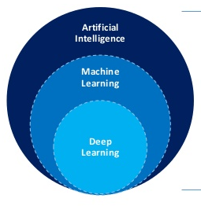
Deep Learning is a type of Machine Learning

Slide 27
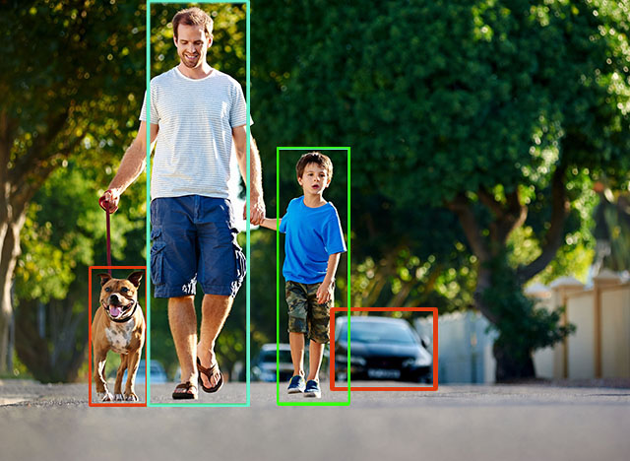
Understanding what’s in an Image

Slide 28
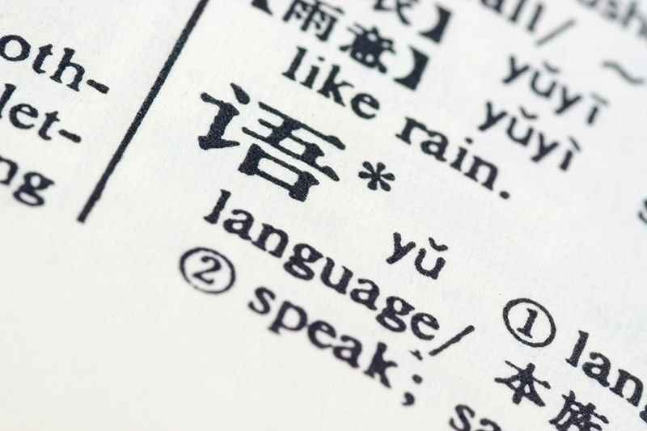
Translating a document

Slide 29
Neural Network

Slide 30
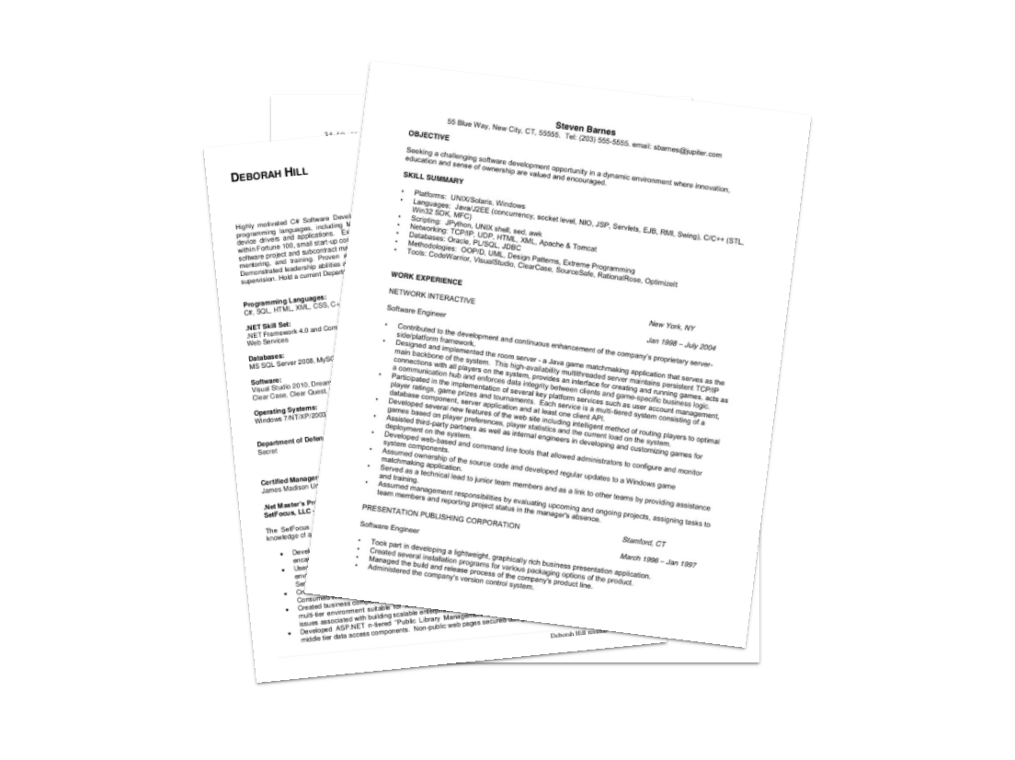

Slide 31
Data
Gender | Experience (yrs.) | Phone Interview | Previous Employer | Onsite Interview
Male | 3 | 7 | 4 | Yes
Female | 1 | 7 | 2 | No
Female | 7 | 9 | 3 | Yes
Male | 4 | 6 | 2 | No
Female | 3 | 8 | 3 | Yes

Slide 32
Data
Gender | Experience (yrs.) | Phone Interview | Previous Employer | Onsite Interview
0 | 3 | 7 | 4 | Yes
1 | 1 | 7 | 2 | No
1 | 7 | 9 | 3 | Yes
0 | 4 | 6 | 2 | No
1 | 3 | 8 | 3 | Yes

Slide 33
Data
Gender | Experience (yrs.) | Phone Interview | Previous Employer | Onsite Interview
0 | 3 | 7 | 4 | 1
1 | 1 | 7 | 2 | 0
1 | 7 | 9 | 3 | 1
0 | 4 | 6 | 2 | 0
1 | 3 | 8 | 3 | 1

Slide 34
Data
Features
Gender | Experience (yrs.) | Phone Interview | Previous Employer | Onsite Interview
0 | 3 | 7 | 4 | 1
1 | 1 | 7 | 2 | 0
1 | 7 | 9 | 3 | 1
0 | 4 | 6 | 2 | 0
1 | 3 | 8 | 3 | 1

Slide 35
Data
Gender | Experience (yrs.) | Phone Interview | Previous Employer | Onsite Interview
0 | 3 | 7 | 4 | 1
1 | 1 | 7 | 2 | 0
1 | 7 | 9 | 3 | 1
0 | 4 | 6 | 2 | 0
1 | 3 | 8 | 3 | 1
Target

Slide 36
Data
Gender | Experience (yrs.) | Phone Interview | Previous Employer | Onsite Interview
0 | 3 | 7 | 4 | 1
1 | 1 | 7 | 2 | 0
1 | 7 | 9 | 3 | 1
0 | 4 | 6 | 2 | 0
1 | 3 | 8 | 3 | 1
Labels

Slide 37
OUTPUT
Onsite
Interview

Slide 38
INPUT
OUTPUT
Gender
Experience
Onsite
Interview
Phone Interview
Previous Employer

Slide 39
INPUT
OUTPUT
Gender
Experience
Onsite
Interview
Phone Interview
Previous Employer
Neuron

Slide 40
INPUT
OUTPUT
Gender
Experience
Onsite
Interview
Phone Interview
Previous Employer

Slide 41
INPUT
OUTPUT
Gender
Experience
Onsite
Interview
Phone Interview
Previous Employer

Slide 42
INPUT
OUTPUT
Gender
Experience
Onsite
Interview
Phone Interview
Previous Employer

Slide 43
INPUT
OUTPUT
Salary
Gender
Experience
Onsite
Interview
Phone Interview
Previous Employer

Slide 44
INPUT
OUTPUT
Salary
Gender
Experience
Onsite
Interview
Phone Interview
Previous Employer

Slide 45
INPUT
OUTPUT
Salary
Gender
Experience
Onsite
Interview
Phone Interview
Previous Employer

Slide 46
INPUT
OUTPUT
Salary
Gender
Fit
Experience
Onsite
Interview
Phone Interview
Previous Employer

Slide 47
INPUT
OUTPUT
Salary
Gender
Fit
Experience
Onsite
Interview
Phone Interview
Previous Employer

Slide 48
INPUT
OUTPUT
Salary
Gender
Fit
Experience
Onsite
Interview
Phone Interview
Previous Employer

Slide 49
INPUT
OUTPUT
Salary
Gender
Fit
Experience
Onsite
Interview
Phone Interview
Aptitude
Previous Employer

Slide 50
INPUT
OUTPUT
Salary
Gender
Fit
Experience
Onsite
Interview
Phone Interview
Aptitude
Previous Employer

Slide 51
INPUT
OUTPUT
Salary
Gender
Fit
Experience
Onsite
Interview
Phone Interview
Aptitude
Previous Employer

Slide 52
INPUT
OUTPUT
Salary
Gender
Fit
Experience
Onsite
Interview
Phone Interview
Aptitude
Previous Employer

Slide 53
INPUT
OUTPUT
Salary
Gender
Fit
Experience
Onsite
Interview
Phone Interview
Aptitude
Previous Employer

Slide 54
INPUT
OUTPUT
Salary
Gender
Fit
Experience
Onsite
Interview
Phone Interview
Aptitude
Previous Employer

Slide 55
INPUT
Gender
Experience
Phone Interview
Previous Employer

Slide 56
INPUT
OUTPUT
Gender
Experience
Onsite
Interview
Phone Interview
Previous Employer

Slide 57
INPUT
Neural Network
OUTPUT
Gender
Experience
Onsite
Interview
Phone Interview
Previous Employer

Slide 58

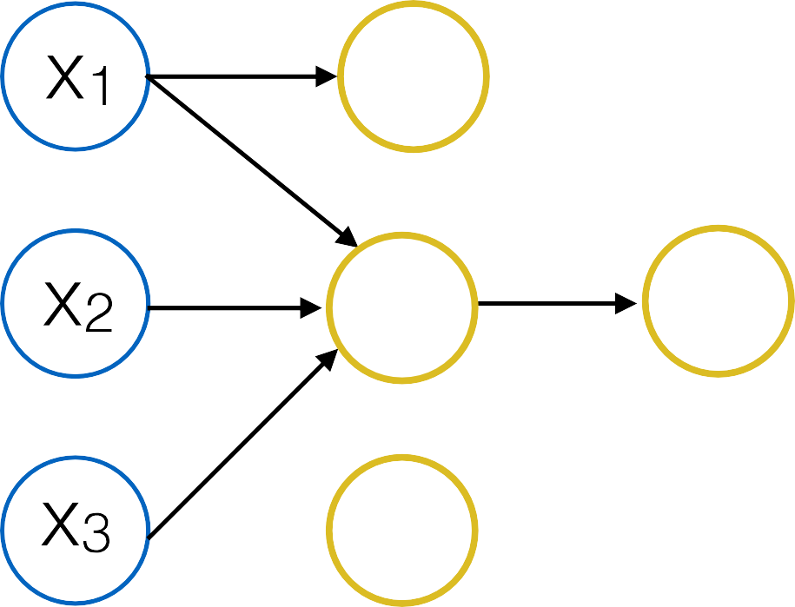




Slide 59





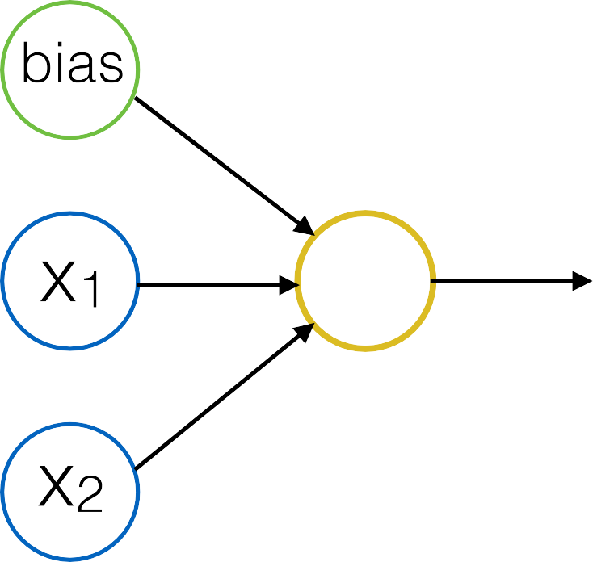

Slide 60



Slide 61
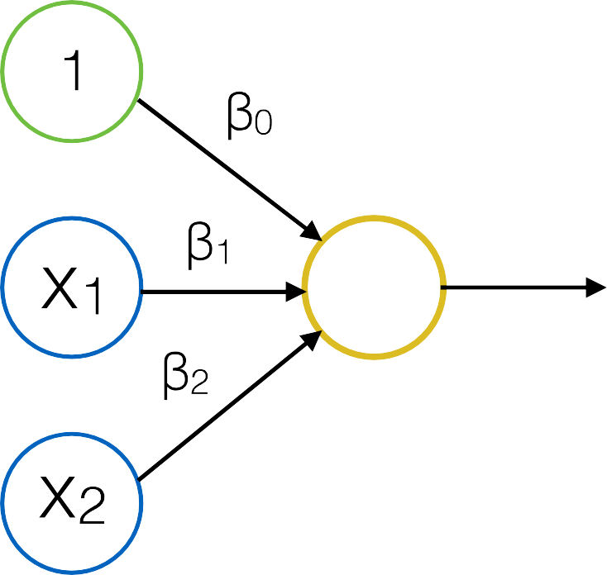

Slide 62



Slide 63














Slide 64














Slide 65
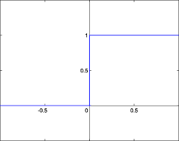
Step Function

Slide 66
























Slide 68
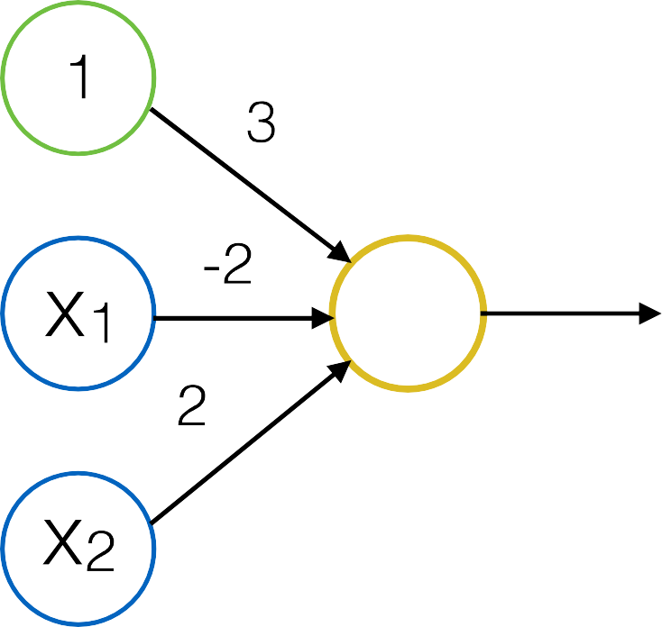

Slide 69
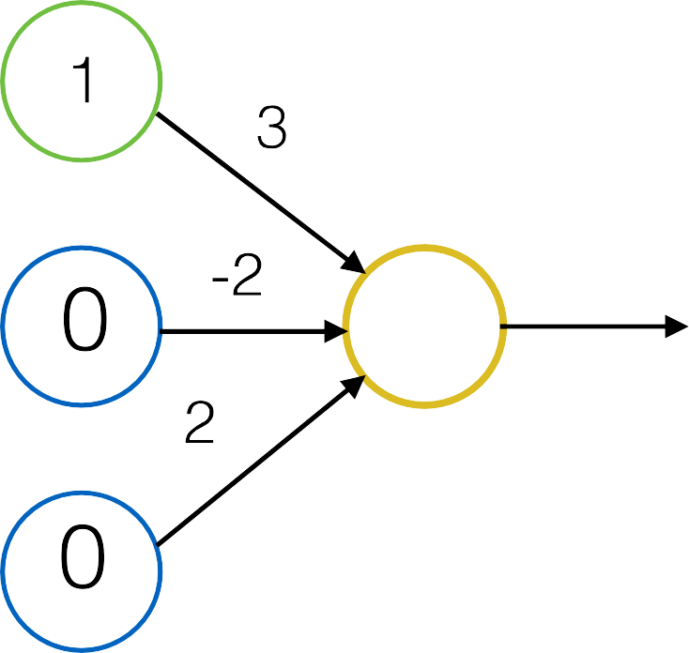

Slide 72




Slide 73




































Slide 74


































Slide 75























Slide 76








Slide 77




Slide 80
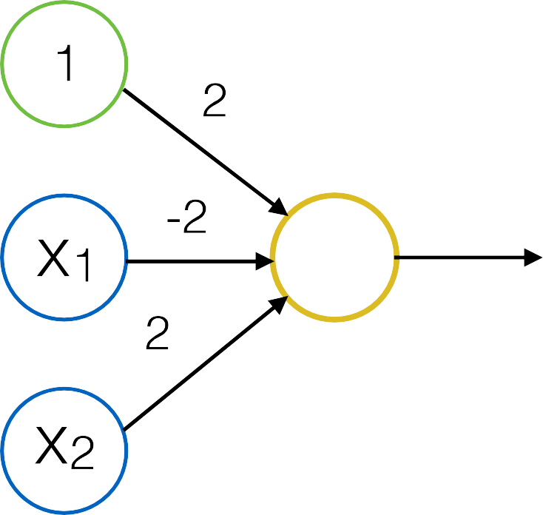

Slide 81
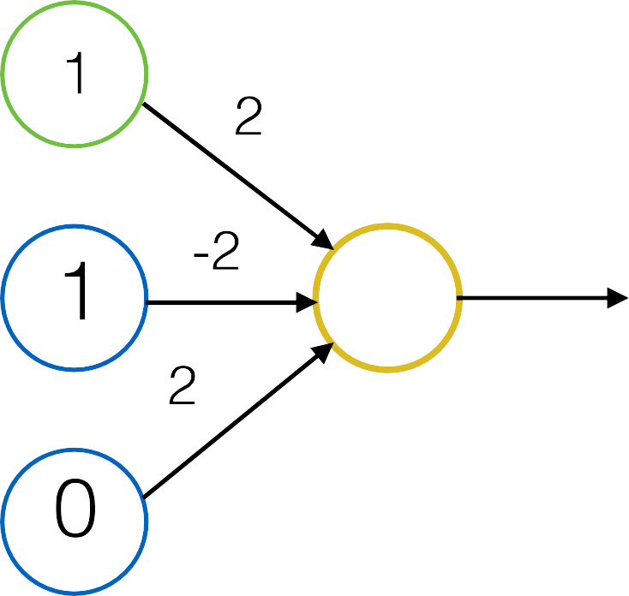

Slide 83
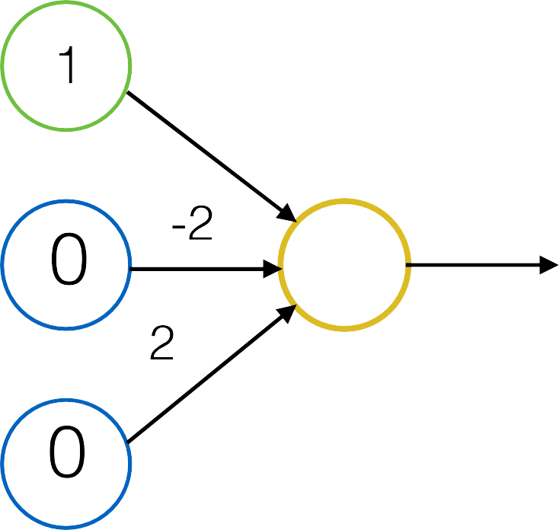

Slide 90


Slide 92


Slide 93
epoch

Slide 94














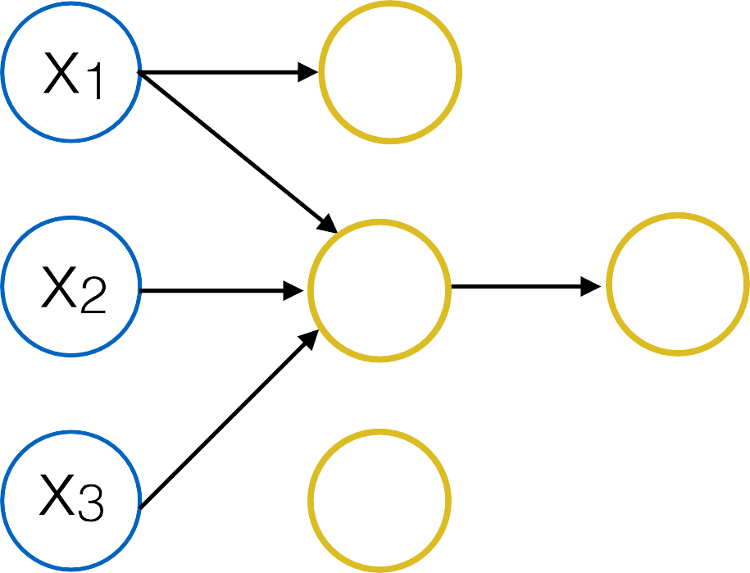

Slide 95




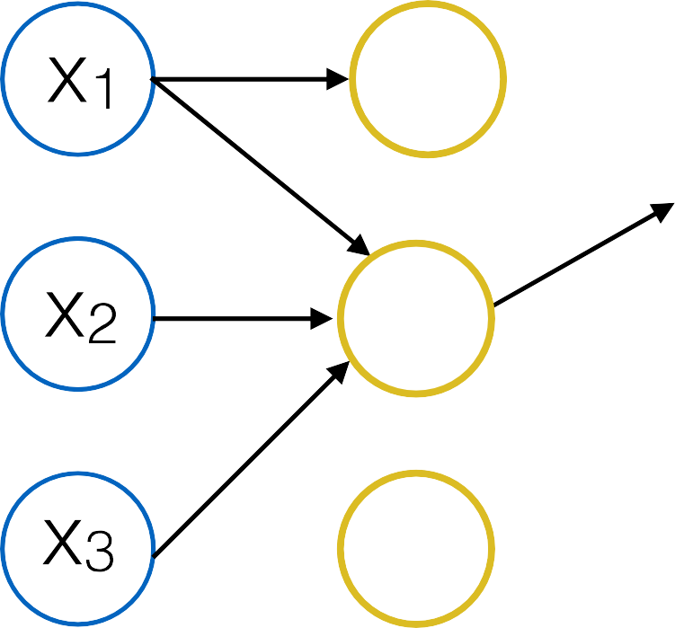

Slide 96
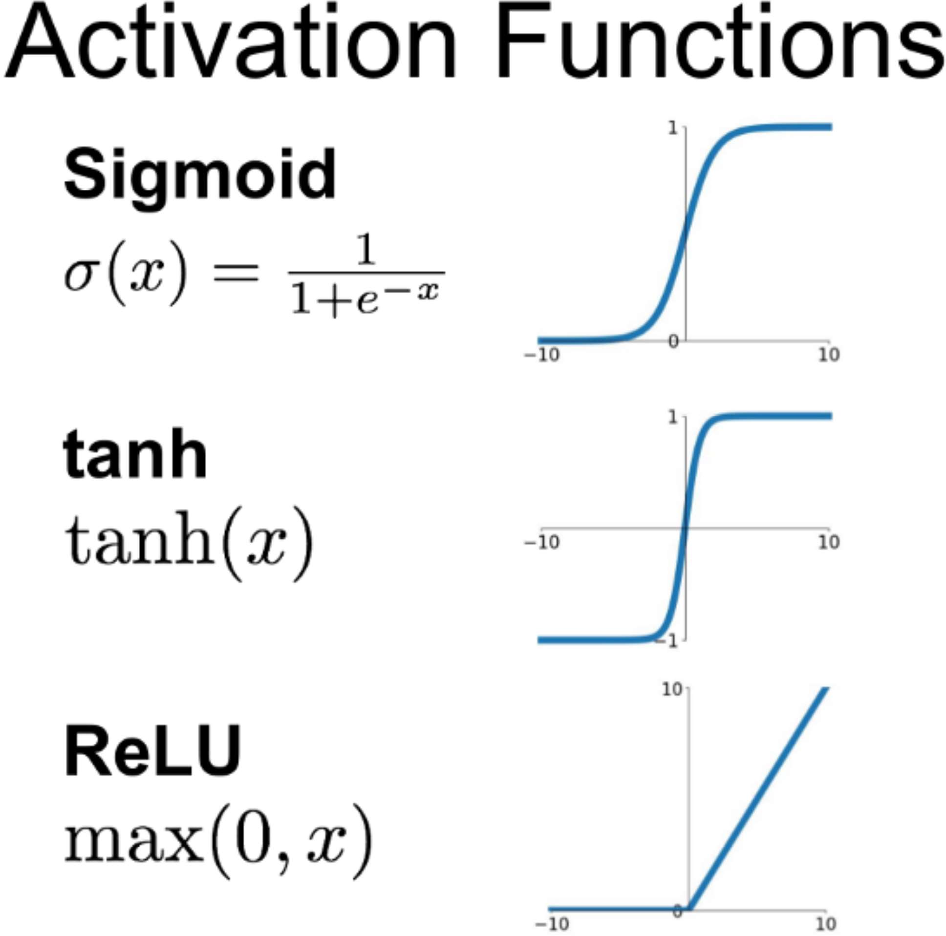

Slide 98
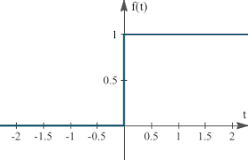
Step Function

